Slide 1
Chapter 5: Advanced SQL
西电学堂 xt.xidian.edu.cn 搜索“数据库”

Slide 2
Outline
Accessing SQL From a Programming Language
Functions and Procedural Constructs
Triggers

Slide 3
Accessing SQL From a Programming Language

Slide 4
Accessing SQL From a Programming Language
How do we enable a database to interact “ordinary” program that are written in C or Java?
How do we deal with the difference in data-types supported by SQL and C or Java? In particular, relations are the results of queries
How do we manage connections to a database when these connects are shared between many short-lived processes?

Slide 5
Accessing SQL From a Programming Language
预编译
  嵌入式SQL等（ ISO standard specifies embedded support for C, C++, Java, Fortran, COBOL, PL/1 ）
  OCCI （Oracle C++ Call Interface）
  OCILIB （针对Oracle的开源库，封装oci）
统一的数据访问接口
  ODBC（Open Database Connectivity ）works with C, C++, C#, and Visual Basic. Other API’s such as ADO.NET sit on top of ODBC
  ADO（ActiveX Data Objects ）
  JDBC（Java访问数据库的方式）
  DAO/RDO（本地数据库/远程数据库）
  OLE DB（包括非结构数据的访问）

Slide 6
Embedded SQL

Slide 7
Embedded SQL
A language to which SQL queries are embedded is referred to as a host language, and the SQL structures permitted in the host language comprise embedded SQL.
EXEC SQL statement is used to identify embedded SQL request to the preprocessor
EXEC SQL <embedded SQL statement >;
Note: this varies by language:
  In some languages, like COBOL, the semicolon is replaced with END-EXEC
  In Java embedding uses # SQL { …. };

Slide 8
Example
例：建立一个“学生”表Student
EXEC SQL CREATE TABLE Student
    (Sno CHAR(5) NOT NULL UNIQUE,
    Sname CHAR(20),
    Ssex CHAR(1),
    Sage INT,
    Sdept CHAR(15));

Slide 9
Example
    /* Program to create student table */
    #include <stdio.h>
    #include <stdlib.h>
    EXEC SQL INCLUDE sqlca;
    Main()
    { EXEC SQL BEGIN DECLARE SECTION;
    char *username = “ Manager/Manager”;
    char *connect String= “College”
    EXEC SQL END DECLARE SECTION;
    /* connect to database*/
    EXEC SQL CONNECT :connectString USER :username ;
    if (sqlca.sqlcode < 0 ) exit (-1);

Slide 10
Example
    /* display message for user and create the table */
    printf (“ Creating student table \n”);
    EXEC SQL CREATE TABLE Student
    (Sno CHAR(5) NOT NULL UNIQUE,
    Sname CHAR(20),
    Ssex CHAR(1),
    Sage INT,
    Sdept CHAR(15));
    if (sqlca.sqlcode >=0) /*Check success */
    printf (“Creation successful\n”);
    else printf (“Creation unsuccessful\n”);
    /* commit the transaction and disconnect from the db */
    EXEC SQL COMMIT WORK RELEASE;

Slide 11
Embedded SQL (Cont.)
Before executing any SQL statements, the program must first connect to the database. This is done using:
EXEC SQL connect to server user user-name using password;
Close database
EXEC SQL COMMIT WORK RELEASE
EXEC SQL DISCONNCET [connection]

Slide 12
Embedded SQL (Cont.)
Without query results: embedded SQL statements do not produce any query results
  Non-select statement, e.g. INSERT, UPDATE, DELETE, CREATE TABLE etc..
With query results: embedded SQL statements produce any query results - Select statement
  Single-row queries, where the query result contains at most one row of data
  Select * from student where sno=“S1”;
  Multi-row queries, where the query result may contain an arbitrary number of rows
  Select * from student where age >=20;

Slide 13
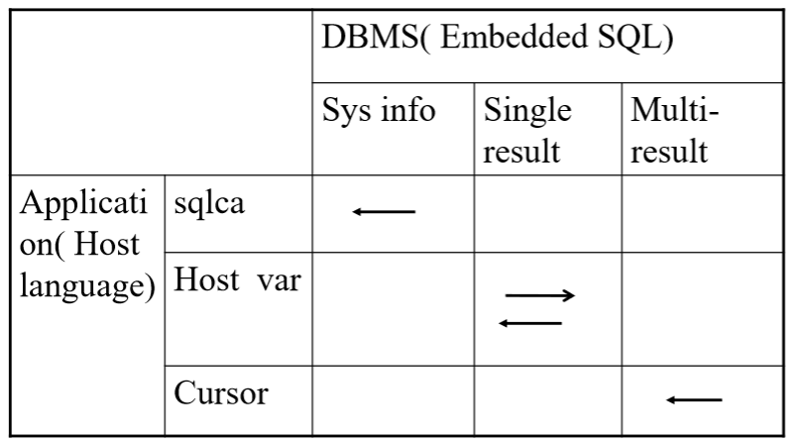
Embedded SQL (Cont.)
Communication between Application vs. DBMS

Slide 14
Embedded SQL (Cont.)
SQL Communication Area (SQLCA)
DBMS information -> applications
Host Language variable (主变量)
Single result from DBMS to applications
Single result from application to DBMS
Cursor (游标)
Multiple results from DBMS to applications

Slide 15
SQL Communication Area (SQLCA)
The DBMS uses an SQL Communication Area (SQLCA) to report runtime errors to the application
SQLCA is a data structure that contains error variables and status indicators
An application program can examine the SQLCA to determine the success or failure of each SQL statement
EXEC SQL INCLUDE sqlca
  This tells the precompiler to include the SQLCA data structure in the program

Slide 16
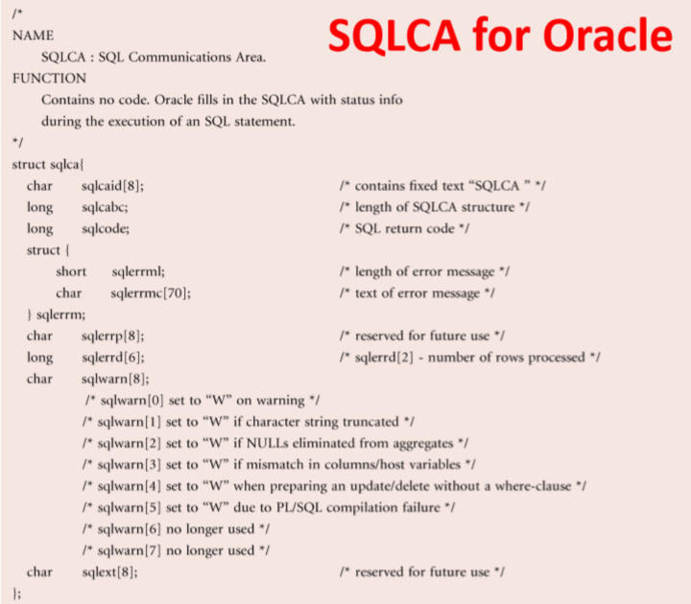

Slide 17
SQL Communication Area (SQLCA)
The most important part of the structure is the SQLCODE variable
SQLCODE is set by DBMS as follows:
  Zero: statements executed successful (maybe there warning message in sqlwarn
  Negative: error occurred. The value indicates specific error that occurred
  Positive: statements executed successful, but an exceptional condition occurred

Slide 18
Example
    /* display message for user and create the table */
    printf (“ Creating student table \n”);
    EXEC SQL CREATE TABLE Student
    (Sno CHAR(5) NOT NULL UNIQUE,
    Sname CHAR(20),
    Ssex CHAR(1),
    Sage INT,
    Sdept CHAR(15));
    if (sqlca.sqlcode >=0) /*Check success */
    printf (“Creation successful\n”);
    else printf (“Creation unsuccessful\n”);
    /* commit the transaction and disconnect from the db */
    EXEC SQL COMMIT WORK RELEASE;

Slide 19
Host Language Variables (主变量)
Host language variables can be used in embedded SQL statements to transfer data from database into the program, and vise versa
They can be used in anywhere that a constant can appear in SQL statements
They can not be used to represent database objects, such as table or column names

Slide 20
Host Language Variables (主变量)
They are preceded by a colon (:) to distinguish from SQL variables
EXEC SQL UPDATE student
SET age= age+ :increment
WHERE SSN=“2345”;
Variables used as above must be declared within DECLARE section. The syntax for declaring the variables, however, follows the usual host language syntax.
EXEC-SQL BEGIN DECLARE SECTION
int increment;
EXEC-SQL END DECLARE SECTION;

Slide 21
Usage of Host Language Variables
Input host language variables
  Specify the data inserted into the database
  Modify the data in the database to the specified value
  Perform the specified operation
  Specify conditions in the WHERE clause or HAVING clause
Output host language variables
  Get the result of the SQL statement
  Get the execution status of the SQL statement
  A host language variable may be both an input host variable and an output host variable

Slide 22
Indicator Variables (指示变量)
A host language variable can be accompanied by an indicator variable to indicate the value of the host variable
  The input host variable can be nulled with the indicator variable
  The output host variable can use the indicator variable to detect whether the value is null
  The meaning of the indicator variable is as follow:
  0 : associated host variable contains a valid value
  -1 : associated host variable should be assumed to contain a null
  >0 : associated host variable contains a valid value, which may have been rounded or truncated ( host variable was not large enough to hold the value)

Slide 23
Indicator Variables (指示变量)
For example: Set the age of student “2345” to NULL
EXEC SQL BEGIN DECLARE SECTION;
int age;
short ageInd;
EXEC SQL END DECLARE SECTION;
ageInd =-1;
EXEC SQL UPDATE student
SET age= :age :ageInd;
WHERE SSN= “2345”;

Slide 24
Single-row Queries
In embedded SQL, single-row queries are handled by the singleton select statement.
EXEC SQL SELECT [ALL|DISTINCT] <目标列表达式>[,<目标列表达式>]...
INTO <主变量>[<指示变量>][,<主变量>[<指示变量 >]]...
FROM <表名或视图名>[,<表名或视图名>] ...
[WHERE <条件表达式>]
[GROUP BY <列名1> [HAVING <条件表达式>]]
[ORDER BY <列名2> [ASC|DESC]];

Slide 25
Single-row Queries
使用主变量
  INTO子句
  WHERE子句的条件表达式
  HAVING短语的条件表达式
  使用指示变量
  指示变量只能用于INTO子句中
  如果INTO子句中主变量后面跟有指示变量，则当查询得出的某个数据项为空值时，系统会自动将相应主变量后面的指示变量置为负值，但不向该主变量执行赋值操作，即主变量值仍保持执行SQL语句之前的值
  当发现指示变量值为负值时，不管主变量为何值，均应认为主变量值为NULL

Slide 26
Single-row Queries
查询结果为空集
  如果数据库中没有满足条件的记录，即查询结果为空
查询结果为多条记录
  程序出错，DBMS会在SQLCA中返回错误信息

Slide 27
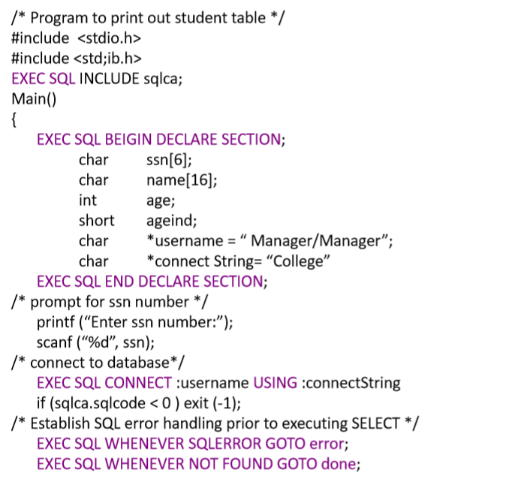
Single-row Queries

Slide 28
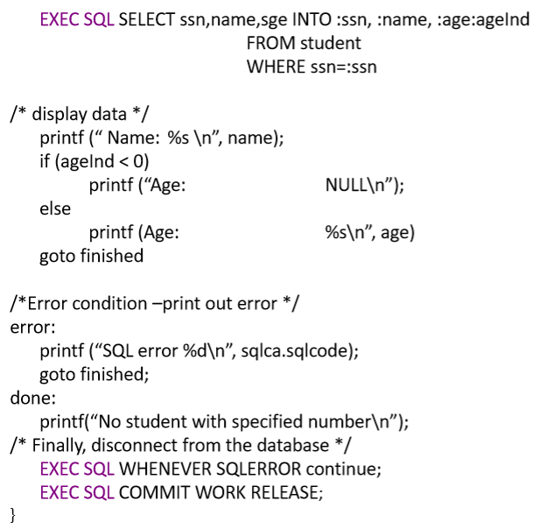
Single-row Queries

Slide 29
Multi-row Queries and Cursors
Most high-level programming languages can process only individual data items or individual rows of a structure whereas SQL can process multiple rows of data
To overcome the impedance mismatch, SQL provides a mechanism for allowing the host language to access the rows of a query result one at a time, cursor

Slide 30
Cursors
Usage of cursors
  Declare 说明游标
  Open 打开游标
  Fetch 移动游标指针，然后取当前记录
  Close 关闭游标

Slide 31
Cursors
To write an embedded SQL query, we use the
EXEC SQL DECLARE c CURSOR FOR <SQL query>
statement. The variable c is used to identify the query
Example:
  From within a host language, find the ID and name of students who have completed more than the number of credits stored in variable credit_amount in the host langue
  EXEC SQL DECLARE c CURSOR FOR
  select ID, name
  from student
  where tot_cred > :credit_amount

Slide 32
Cursors
The open statement for our example is as follows:
EXEC SQL OPEN c ;
This statement causes the database system to execute the query and to save the results within a temporary relation.
The query uses the value of the host-language variable credit-amount at the time the open statement is executed.

Slide 33
Cursors
The fetch statement causes the values of one tuple in the query result to be placed on host language variables.
EXEC SQL FETCH [[NEXT|PRIOR|FIRST|LAST] FROM] c INTO :si, :sn
Repeated calls to fetch get successive tuples in the query result
  NEXT：向前推进一条记录
  PRIOR：向回退一条记录
  FIRST：推向第一条记录
  LAST：推向最后一条记录
  缺省值为NEXT

Slide 34
Cursors
  说明
  (1) 主变量必须与SELECT语句中的目标列表达式具有一一对应关系
  (2) FETCH语句通常用在一个循环结构中，通过循环执行FETCH语句逐条取出结果集中的行进行处理
  (3)当没有记录可读时, SQLCODE 设置为 NOT FOUND
  (4) 为进一步方便用户处理数据，现在一些DBMS对FETCH语句做了扩充，允许用户向任意方向以任意步长移动游标指针

Slide 35
Cursors
The close statement causes the database system to delete the temporary relation that holds the result of the query.
EXEC SQL CLOSE c ;
Note: above details vary with language. For example, the Java embedding defines Java iterators to step through result tuples.

Slide 36
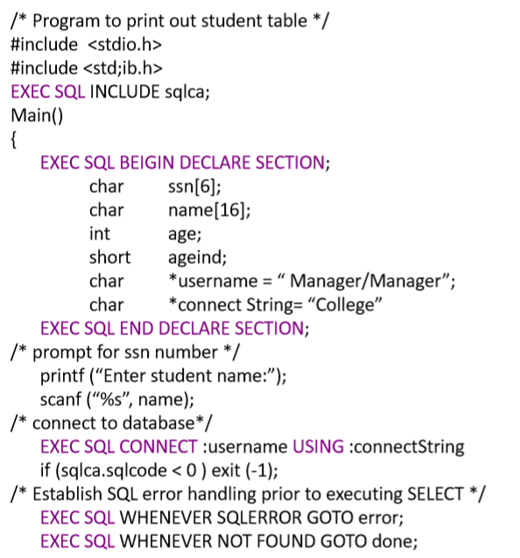
Cursors

Slide 37
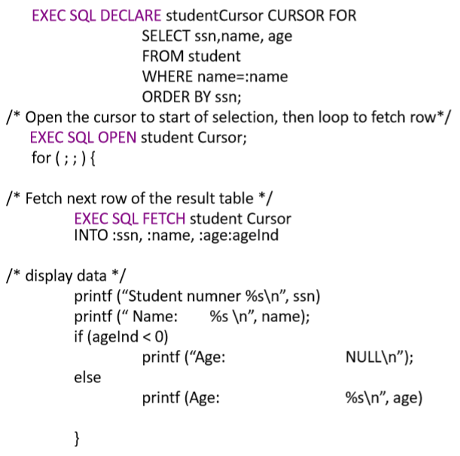
Cursors

Slide 38
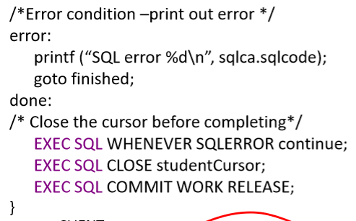
Cursors
Note

Slide 39
Using Cursor to Modify Data
A cursor is either read-only or updatable
If the table/view identified by a cursor is not updatable then the cursor is read-only;
Otherwise, the cursor is updatable, positioned UPDATE and DELETE CURRENT statements can be used.

Slide 40
Using Cursor to Modify Data
Embedded SQL expressions for database modification (update, insert, and delete)
Can update tuples fetched by cursor by declaring that the cursor is for update
EXEC SQL DECLARE c CURSOR FOR
select *
from instructor
where dept_name = ‘Music’
FOR UPDATE
We then iterate through the tuples by performing fetch operations on the cursor (as illustrated earlier), and after fetching each tuple we execute the following code:
EXEC SQL UPDATE instructor
SET salary = salary + 1000
WHERE CURRENT OF c

Slide 41
Using Cursor to Modify Data
The update does not advance the cursor, and so another FETCH must be performed to move the cursor forward to the next row
DELETE
EXEC SQL DELETE FROM TableName
WHERE CURRENT OF cursorName

Slide 42
ODBC

Slide 43
ODBC
Open DataBase Connectivity (ODBC) standard
  standard for application program to communicate with a database server.
  application program interface (API) to
    open a connection with a database,
    send queries and updates,
    get back results.
一个基于ODBC的应用程序对数据库的操作不依赖任何DBMS，不直接与DBMS打交道，所有的数据库操作由对应的DBMS的ODBC驱动程序完成。也就是说，不论是FoxPro、Access 、MYSQL还是Oracle数据库，均可用ODBC API进行访问。由此可见，ODBC的最大优点是能以统一的方式处理所有的数据库。

Slide 44
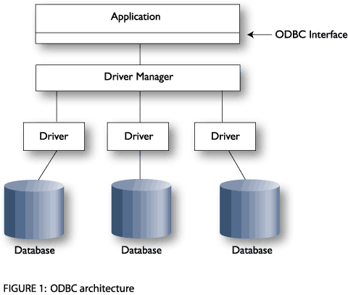
Typical ODBC Architecture

Slide 45
How ODBC Works?
ODBC inserts a middle layer called a Client Driver
Purpose of the Client Driver is to translate the applications queries into commands that the DBMS understands
Driver talks to the DBMS using SQL
Available drivers:
  SQL Server, Access, FoxPro, Excel, dBase, Paradox, text files

Slide 46
Other Parts of the Architecture
Application – calls functions defined in the ODBC API to access a data source
Driver Manager – implements the ODBC API and provides information to the application
Database – contains all the data

Slide 47
组成部分
应用程序要访问一个数据库，必须是在ODBC管理器注册了的数据源
ODBC管理器：该程序位于Windows 控制面板(Control Panel)的32位ODBC内，其主要任务是管理安装的ODBC驱动程序和管理数据源。
驱动程序管理器：驱动程序管理器包含在ODBC32.DLL中，对用户是透明的。其任务是管理ODBC驱动程序，是ODBC中最重要的部件。
ODBC API：ODBC编程接口，提供常用的类(CDatabase、CRecordset)、方法。
ODBC驱动程序：是一些DLL，提供了ODBC和数据库之间的接口
数据源：数据源包含了数据库位置和数据库类型等信息，实际上是一种数据连接的抽象。

Slide 48
使用ODBC连接数据库
在访问ODBC数据源时需要ODBC驱动程序的支持。微软和Oracle公司都提供了Oracle数据库的ODBC驱动，Oracle为自己写的ODBC驱动功能更细腻一些，支持的API也更全一些。Oracle的ODBC驱动是依赖于OCI的客户端库的。OCI Client和Oracle DB Server之间通过TNS服务作为桥梁，因此要用上ODBC，还得为Oracle数据库服务器配置一个db service name，这个使用Net Manager或者Net Assistant都可以完成，甚至直接修改tnsnames.ora文件也可以（远程连接数据库时）。
Notes:
Database Lab.USTC,Hefei,China

Slide 49
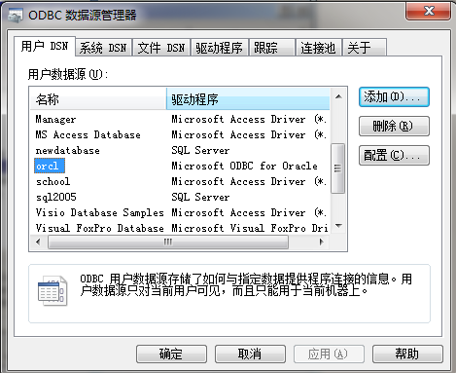
ODBC数据源设置
1.控制面板→管理工具→数据源 (ODBC) → 用户DSN
添加新的数据源
点击添加

Slide 50
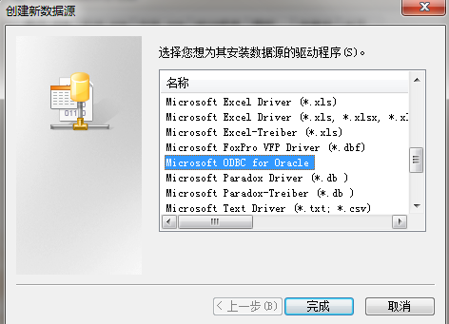
ODBC数据源设置
2.选择所要添加的数据源类型，选择后点击“完成”

Slide 51
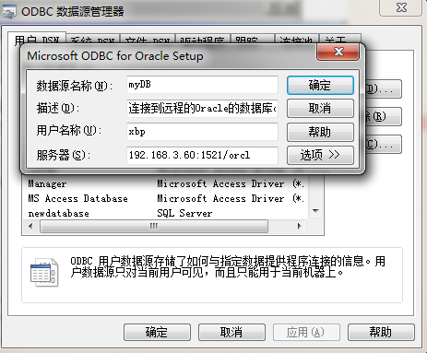
ODBC数据源设置
3.配置Oracle ODBC驱动
自己取DSN
的名称
配置Oracle
服务器
本地服务器127.0.0.1

Slide 52
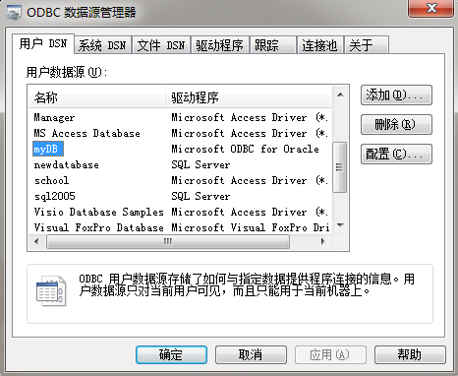
ODBC数据源设置
4.配置完成，可以在ODBC数据源管理程序中看到新添加 Oracle数据源

Slide 53

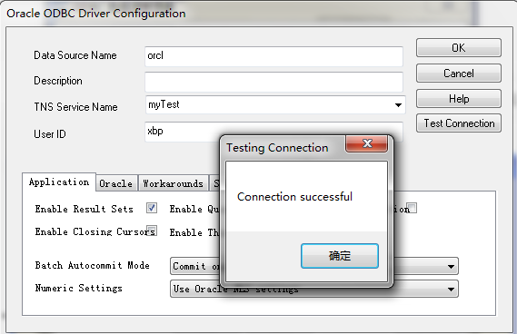
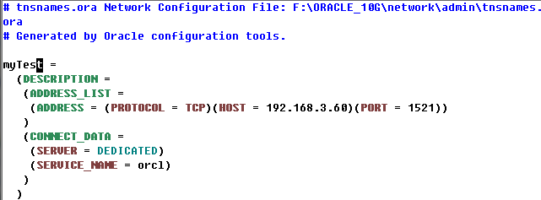
使用Oracle ODBC driver

Slide 54
ODBC
MFC 基类库定义了几个数据库类。在利用ODBC 编程时，经常要使用到：
CDatabase 类对象提供了对数据源的连接，通过它你可以对数据源进行操作。
CRecordSet 类对象提供了从数据源中提取出的记录集。
CRecordView 类对象能以控制的形式显示数据库记录。这个视图是直接连到一个CRecordSet 对象的表视图。

Slide 55
JDBC

Slide 56
JDBC
JDBC is a Java API for communicating with database systems supporting SQL.
JDBC also supports metadata retrieval, such as querying about relations present in the database and the names and types of relation attributes.
Model for communicating with the database:
  Open a connection
  Create a “statement” object
  Execute queries using the Statement object to send queries and fetch results
  Exception mechanism to handle errors

Slide 57
JDBC与ODBC比较
  ODBC不太适合在Java中直接使用
    ODBC是一个C语言实现的API，从Java程序调用本地的C程序会带来一系列类似安全性、完整性、健壮性的问题
  完全精确实现从C代码ODBC到Java API写的ODBC的翻译并不令人满意，比如指针。
  Java API对纯Java方案来说是必须的
    ODBC驱动器和驱动管理器移植
    Java写的JDBC驱动适应任何Java平台

Slide 58


JDBC Architecture
With JDBC, the application programmer uses the JDBC API
  The developer never uses any proprietary APIs
Any proprietary APIs are implemented by a JDBC driver
Java Application
JDBC API
JDBC DriverManager
JDBC Driver
JDBC Driver

Slide 59
JDBC Drivers
There are 4 types of JDBC Drivers
  Type 1 - JDBC-ODBC Bridge
  Type 2 - JDBC-Native Bridge
  Type 3 - JDBC-Net Bridge
  Type 4 - Direct JDBC Driver

Slide 60
JDBC driver type-1
Uses the existing API.
Type 1 only runs on platforms where ODBC is available
Not the fastest
JDBC-ODBC Bridge
Java
ODBC Driver
Native Driver
Non Java
Net Driver

Slide 61
JDBC driver type-2
Uses vendor-provided local libraries
Type 2 Drivers map between a proprietary Database API and the JDBC API
Most efficient
JDBC Driver
Java
Native Driver
Non Java
Net Driver

Slide 62
JDBC driver type-3 & 4
100% java.
Type 3 Drivers are used with middleware products
Type 4 Drivers are written in Java
In most cases, type 4 drivers are preferred
JDBC – Net Driver
Java
JDBC Driver
Implements a proprietary
Protocol in java
Java

Slide 63
Complete JDBC Architecture
Java Application
JDBC Interface
JDBC Driver Manager
JDBC Driver Interface
JDBC Net Driver A
JDBC–ODBC Bridge B
JDBC Driver C
JDBC Driver D
ODBC Driver
Native Driver C
Native Driver B
A
B
C
D

Slide 64
JDBC Interface classes
Java.sql package
  DriverManager
  Connection
  Statement
  CallableStatement
  PreparedStatement
  Resultset
  ResultSetMetaData
  DatabaseMetatData

Slide 65

JDBC Interface classes
DriverManager
  Manages JDBC Drivers
  Used to Obtain a connection to a Database
Connection
  Represents a connection to a specific database
  Used for creating statements
  Used for managing database transactions
  Used for accessing stored procedures
  Used for creating callable statements
Statement
  Used for executing SQL statements against the database

Slide 66
JDBC Interface classes
ResultSet
  Represents the result of an SQL statement
  Provides methods for navigating through the resulting data
PreparedStatement
  Similar to a stored procedure
  An SQL statement (which can contain parameters) is compiled and stored in the database
CallableStatement
  Used for executing stored procedures
DatabaseMetaData
  Provides access to a database's system catalogue
ResultSetMetaData
  Provides information about the data contained within a ResultSet

Slide 67
JDBC Interface classes
To execute a statement against a database, the following flow is observed
  Load the driver (Only performed once)
  Obtain a Connection to the database (Save for later use)
  Obtain a Statement object from the Connection
  Use the Statement object to execute SQL. Updates, inserts and deletes return Boolean. Selects return a ResultSet
  Navigate ResultSet, using data as required
  Close ResultSet
  Close Statement
Do NOT close the connection
  The same connection object can be used to create further statements
  A Connection may only have one active Statement at a time. Do not forget to close the statement when it is no longer needed.
  Close the connection when you no longer need to access the database

Slide 68
Loading Drivers
When a JDBC Driver class is loaded, it must create an instance of itself and register that instance with the JDBC DriverManager

Slide 69
Connecting to a Database
Once a Driver is loaded, a connection can be made to the database
The connection is defined by URL
  The URL has the following form:
    jdbc:driver:databasename
  Examples:
    jdbc:odbc:MyOdbcDatabase
    jdbc:postgres:WebsiteDatabase
    jdbc:oracle:CustomerInfo
A connection is obtained in the following manner:
  Connection aConnection = DriverManager.getConnection("jdbc:odbc:myDatabase");

Slide 70
Using a Connection
The Connection interface defines many methods for managing and using a connection to the database
  public Statement createStatement()
  public PreparedStatement prepareStatement(String sql)
  public void setAutoCommit(boolean)
  public void commit()
  public void rollback()
  public void close()
The most commonly used method is createStatement()
  When an SQL statement is to be issued against the database, a Statement object must be created through the Connection

Slide 71
Using a Statement
The Statement interface defines two methods for executing SQL against the database
  public ResultSet executeQuery(String sql)
  public int executeUpdate(String sql)
executeQuery returns a ResultSet
  All rows and columns which match the query are contained within the ResultSet
  The developer navigates through the ResultSet and uses the data as required.
executeUpdate returns the number of rows changed by the update statement
  This is used for insert statements, update statements and delete statements

Slide 72
Using a ResultSet
The ResultSet interface defines many navigation methods
  public boolean first()
  public boolean last()
  public boolean next()
  public boolean previous()
The ResultSet interface also defines data access methods
  public int getInt(int columnNumber) -- Note: Columns are numbered
  public int getInt(String columnName) -- from 1 (not 0)
  public long getLong(int columnNumber)
  public long getLong(String columnName)
  public String getString(int columnNumber)
  public String getString(String columnName)
There are MANY more methods. Check the API documentation for a complete list

Slide 73
JDBC Code
  Import java.sql;
  public static void JDBCexample(String dbid, String userid, String passwd)
{
  try (Connection conn = DriverManager.getConnection(
  "jdbc:oracle:thin:@db.yale.edu:2000:univdb", userid, passwd);
  Statement stmt = conn.createStatement();
  )
  {
  … Do Actual Work ….
  }
  catch (SQLException sqle) {
  System.out.println("SQLException : " + sqle);
  }
}

Slide 74
JDBC Code (Cont.)
Update to database
try {
stmt.executeUpdate(
"insert into instructor values(’77987’, ’Kim’, ’Physics’, 98000)");
} catch (SQLException sqle)
{
System.out.println("Could not insert tuple. " + sqle);
}
Execute query and fetch and print results
  ResultSet rset = stmt.executeQuery(
  "select dept_name, avg (salary)
  from instructor
  group by dept_name");
  while (rset.next()) {
  System.out.println(rset.getString("dept_name") + " " +
  rset.getFloat(2));
  }

Slide 75
JDBC Code Details
Getting result fields:
  rs.getString(“dept_name”) and rs.getString(1) equivalent if dept_name is the first argument of select result.
Dealing with Null values
  int a = rs.getInt(“a”);
  if (rs.wasNull()) Systems.out.println(“Got null value”);

Slide 76
Extensions to SQL

Slide 77
Functions and Procedures
SQL:1999 supports functions and procedures
  Functions/procedures can be written in SQL itself, or in an external programming language (e.g., C, Java).
  Functions written in an external languages are particularly useful with specialized data types such as images and geometric objects.
    Example: functions to check if polygons overlap, or to compare images for similarity.
  Some database systems support table-valued functions, which can return a relation as a result.
SQL:1999 also supports a rich set of imperative constructs, including
  Loops, if-then-else, assignment
Many databases have proprietary procedural extensions to SQL that differ from SQL:1999.

Slide 78
SQL Functions
Define a function that, given the name of a department, returns the count of the number of instructors in that department.
create function dept_count (dept_name varchar(20))
returns integer
begin
declare d_count integer;
select count (* ) into d_count
from instructor
where instructor.dept_name = dept_name
return d_count;
end
The function dept_count can be used to find the department names and budget of all departments with more that 12 instructors.
select dept_name, budget
from department
where dept_count (dept_name ) > 12

Slide 79
SQL functions (Cont.)
Compound statement: begin … end
  May contain multiple SQL statements between begin and end.
returns -- indicates the variable-type that is returned (e.g., integer)
return -- specifies the values that are to be returned as result of invoking the function
SQL function are in fact parameterized views that generalize the regular notion of views by allowing parameters.

Slide 80
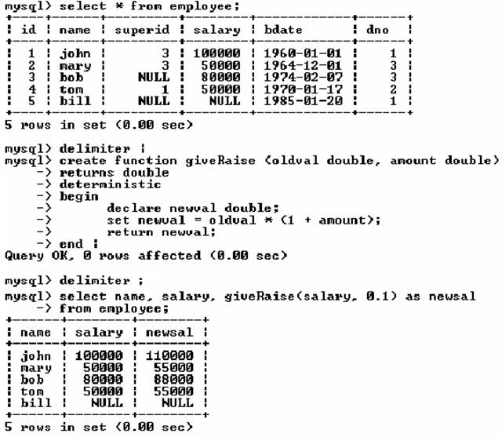
Example of Functions
Change the delimiter of SQL statement from semicolon (;) to something else (e.g., |)
So that you can distinguish between the semicolon of the SQL statements and the terminating character of the function definition

Slide 81
Example of Functions

Slide 82
Table Functions
SQL:2003 added functions that return a relation as a result
Example: Return all instructors in a given department
create function instructor_of (dept_name char(20))
returns table (
ID varchar(5),
name varchar(20),
dept_name varchar(20),
salary numeric(8,2))
return table
(select ID, name, dept_name, salary
from instructor
where instructor.dept_name = instructor_of.dept_name)
Usage
select *
from table (instructor_of (‘Music’))

Slide 83
SQL Procedures
The dept_count function could instead be written as procedure:
create procedure dept_count_proc (in dept_name varchar(20),
out d_count integer)
begin
select count(*) into d_count
from instructor
where instructor.dept_name = dept_count_proc.dept_name
end
Procedures can be invoked either from an SQL procedure or from embedded SQL, using the call statement.
declare d_count integer;
call dept_count_proc( ‘Physics’, d_count);
Procedures and functions can be invoked also from dynamic SQL

Slide 84
Stored Procedures in MySQL
A stored procedure contains a sequence of SQL commands stored in the database catalog so that it can be invoked later by a program
Stored procedures are declared using the following syntax:
  Create Procedure <proc-name>
  (param_spec₁, param_spec₂, …, param_spec_{n} )
  begin
  -- execution code
  end;
  where each param_spec is of the form:
  [in | out | inout] <param_name> <param_type>
  in mode: allows you to pass values into the procedure,
  out mode: allows you to pass value back from procedure to the calling program

Slide 85
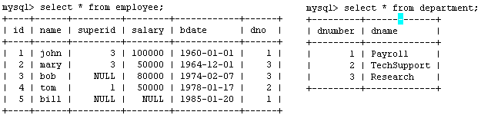
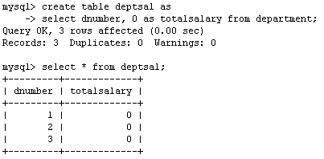
Example
Suppose we want to keep track of the total salaries of employees working for each department
We need to write a procedure to update the salaries in
the deptsal table

Slide 86
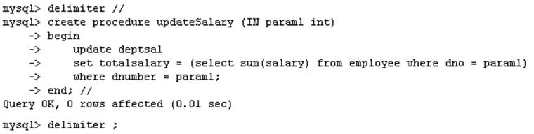
Example
Step 1: Change the delimiter (i.e., terminating character) of SQL statement from semicolon (;) to something else (e.g., //)
So that you can distinguish between the semicolon of the SQL statements in the procedure and the terminating character of the procedure definition

Slide 87
Example
Step 2:
Define a procedure called updateSalary which takes as input a department number.
The body of the procedure is an SQL command to update the totalsalary column of the deptsal table.
Terminate the procedure definition using the delimiter you had defined in step 1 (//)

Slide 88
Example
Step 3: Change the delimiter back to semicolon (;)

Slide 89
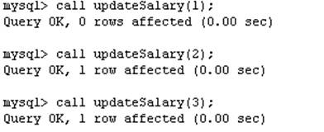
Example
Step 4: Call the procedure to update the totalsalary for each department

Slide 90
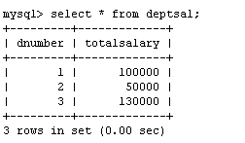
Example
Step 5: Show the updated total salary in the deptsal table

Slide 91
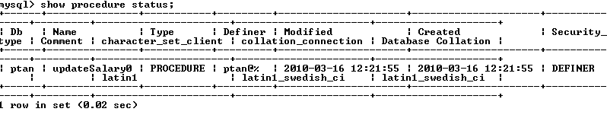

Stored Procedures in MySQL
Use show procedure status to display the list of stored procedures you have created
Use drop procedure to remove a stored procedure

Slide 92
Stored Procedures in MySQL
You can declare variables in stored procedures
You can use flow control statements (conditional IF-THEN-ELSE or loops such as WHILE and REPEAT)

Slide 93
Triggers

Slide 94
Triggers
Stored Procedures and Triggers within a database are similar constructs. They can both perform the same SQL statements.
A stored procedure has to be executed by a user, while a trigger is executed by the system as the result of an event. Events that cause triggers to be activated include data inserts, updates and deletes.
One drawback to using triggers instead of stored procedures is that they cannot accept parameters.

Slide 95
Triggers
A trigger is a statement that is executed automatically by the system as a side effect of a modification to the database.
To design a trigger mechanism, we must:
  Specify the conditions under which the trigger is to be executed.
  Specify the actions to be taken when the trigger executes.

Slide 96
Triggers
To monitor a database and take a corrective action when a condition occurs
CREATE TRIGGER trigger-name
trigger-time trigger-event
ON table-name
FOR EACH ROW
trigger-action;
  trigger-time ∈ {BEFORE, AFTER}
  trigger-event ∈ {INSERT,DELETE,UPDATE}
Values of attributes before and after an update can be referenced
  old row : for deletes and updates
  new row : for inserts and updates

Slide 97
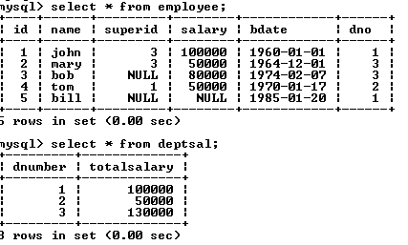
SQL Triggers: An Example
We want to create a trigger to update the total salary of a department when a new employee is hired

Slide 98
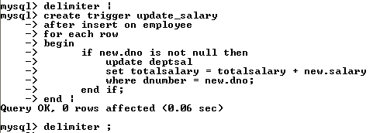
SQL Triggers: An Example
Create a trigger to update the total salary of a department when a new employee is hired:
The keyword “new” refers to the new row inserted

Slide 99
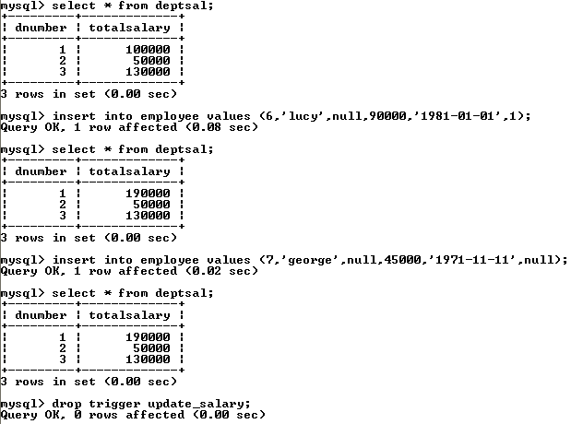
SQL Triggers: An Example
totalsalary increases by 90K
totalsalary did not change

Slide 100
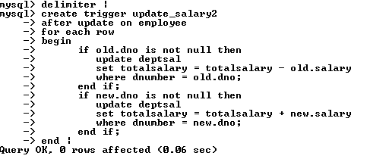
SQL Triggers: An Example
A trigger to update the total salary of a department when an employee tuple is modified:

Slide 101
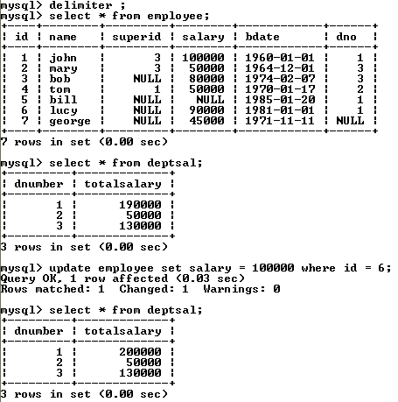
SQL Triggers: An Example

Slide 102
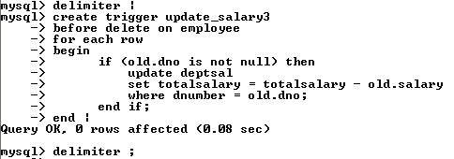
SQL Triggers: An Example
A trigger to update the total salary of a department when an employee tuple is deleted:

Slide 103
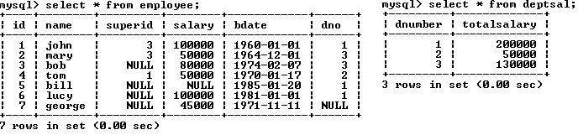
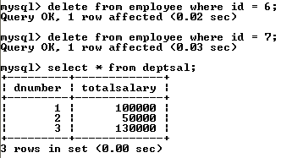
SQL Triggers: An Example

Slide 104
Statement Level Triggers
Instead of executing a separate action for each affected row, a single action can be executed for all rows affected by a transaction
  Use for each statement instead of for each row
  Use referencing old table or referencing new table to refer to temporary tables (called transition tables) containing the affected rows
  Can be more efficient when dealing with SQL statements that update a large number of rows
Note: MySQL 5.7 does not support triggers using FOR EACH STATEMENT.

Slide 105
Statement Level Triggers
Example: Store the count of employees having salary > 10,000 in table R.
  Create Triggle EmpBounus
  After Insert Or Update of Salary Or Delete On Employee
  For Each Statement
  Begin
    delete from R;
    insert into R(cnt) Select count(*) from employee
        Where salary >10000；
  End;

Slide 106
End of Chapter 5

